Slide 1
City of Derby, CT
S&P Global Rating
Presentation
7/23/19

Slide 2
How Did We Get Here?
BOAT adopted budget utilizing revenue figures that double counted State funds 2X (FY16-17, FY17-18 and FY18-19)
Revenue for Formula Grants were over estimated (FY16-17 and FY17-18 and FY18-19)
Due to issues with cut-off dates for expenditures- BOE A/P reversed by auditor to previous year (17-18) resulting in restating FB
Medical costs exceed budget by $1M (FY17-18)

Slide 3
Eight Point Recovery Plan
Debt Restructuring
Sale of Assets
Mil Rate Increase
Adjust Long Term Costs
Tax Sale
Structured Organizational Changes
Grand List Growth
Fund Balance Replenishment as % of Revenue

Slide 4
1) Debt Restructuring
Restructuring/refinancing all non-sewer debt for FY19-20 and FY20-21
FY19-20 Operating Budget includes amount in taxes, funds go directly to Fund Balance Replenishment
FY19-20 = $1.8M
FY20-21 = $1..5M

Slide 5
2) Sale of Assets
City selling assets/properties that are city owned and not part of city use
IE- VARCA Property- $450,000
Commerce Park - $350,000
Vacant Residential Properties (add to Tax Rolls and zone restricted)

Slide 6
3) Mil Rate Increase
BOAT (Board of Apportionment and Taxation) approved a 2.5 mil increase for FY19-20
Increase equals a 6.35%
No Mil increase over the last three fiscal years
CPI increased 6.5% in same period
Recognition of budget issue relative to revenue overstatement

Slide 7
4) Adjust Long Term Costs
Current Defined Benefit Pension Plan at 86% funding level
Annual Contribution of $740K adjusted in FY18-19 and FY19-20 to $200K
Delta directed to Fund Balance Replenishment
$540K in FY 18-19 , $540K in 19-20
Current performance- plan will still remain in low 80% funding level
2% adjustment for each $540K
$60K additional contribution for 10yr

Slide 8
5) Tax Sale
Legislative body approved administration to proceed with next steps in conducting Tax Sale
City reserves the right to select eligible taxes
All payment plans would be honored
Some delinquent taxes will remain on the books
Estimated value - $1M (would go directly to Fund Balance Replenishment if executed)

Slide 9
6) Structured Organizational Changes
Complete review, assignment and execution of auditors findings and recommendations
Additional staff budgeted for segregation of duties and timely reconciliation
Additional oversight of BOE operating budget and grants
Double Entry Accounting (BOE and City)
Adjusting roles and responsibilities

Slide 10
7) Grand List Growth
Working to shift tax burden from home owners to commercial base by growing commercial base
IE- Main Street Development
Fuel Cell
Sale of VARCA
Route 34 Main Street Widening Project
Zone Text Changes (N and S Side of Main St)
Additional 14 acres owned by the City, left to sell and develop

Slide 11
Fund Balance Replenishment
BOAT has a policy on Fund Balance levels
BOAT to modify and update Fund Balance Replenishment Policy
New Policy- 10-15% of Expenditures
Incremental steps to replenishment
Identified Fund Balance Replenishment steps result in approx $5.9M going directly to FB over next 12 months

Slide 12
Summary of Fund Balance Replenishment
Debt Restructuring – FY19-20= $1.8M FY20-21 = $1.5M
Sale of Assets= $450M
Adjust Long Term Costs = $1.1M
Tax Sale (est) = $1.0M
TOTAL = $5.85M (est) (w/o Grand List Growth)
TOTAL = $4.85M (est) (w/o Tax Sale)
NOTE: Neg FB of $2.5M (as of 6/18, est. to be $3.5M as of 6/19)

Slide 13
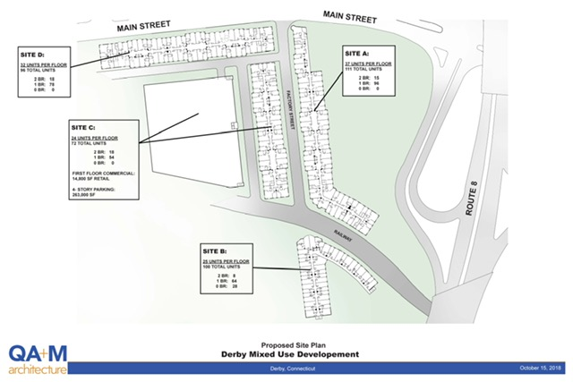

Slide 14
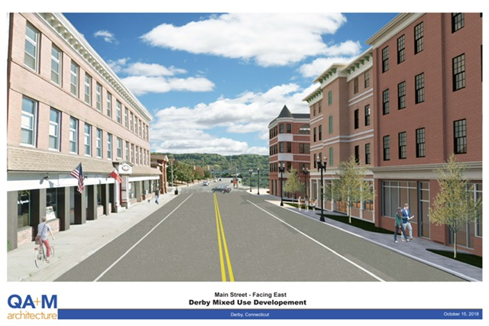

Slide 15
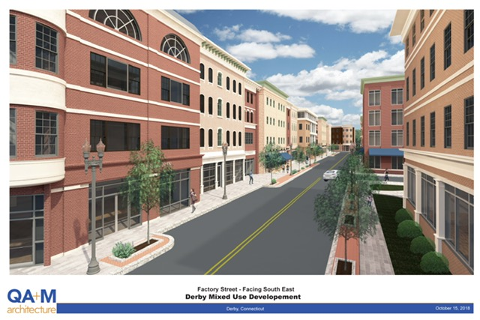

Slide 16
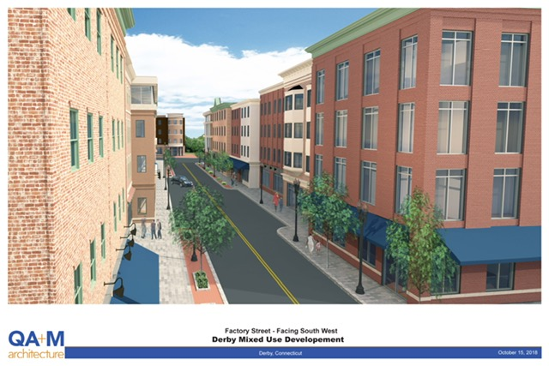

Slide 17
Main Street Development Estimates
Estimated unit value= $90k
Estimated number of units= 379
Estimated Value= $34M
@ 70% value= $23.8M
Estimated NEW tax revenue= $997K

Slide 18
Continued Focus On Success
Pay As You Go Capital Plan
Funding Long Term Liabilities
Tax Collections Remain Above 98%
Growing Commercial Tax Base
Conservative Budgeting
Working Relationship with BOE (Alliance)
Replenish Fund Balance

